Slide 1
Predicting the need for tracheostomy in infants with severe bronchopulmonary dysplasia
October 16, 2023
Robin McKinney, MD
Jon Levin, MD

Slide 2
Bronchopulmonary Dysplasia
Most common complication of prematurity with the severe form affecting 10,000-15,000 infants each year
Sequela of being born extremely premature
Multifactorial: substantial impact of individual susceptibility (genetic, epigenetic)
Fibrosis and metaplasia within the lungs. Fewer, larger ”alveoli”, decreased pulmonary vascular development = “simplified lung”

Slide 3
BPD: Definitions
BPD | NHLBI (2001) At 36 weeks PMA | NHLBI (2018) At 36 weeks PMA | Jensen (2019) At 36 weeks PMA
Mild (Grade 1) | ≥28 days of O₂ Room air at 36 wks | NIPPV (21%) NC (≥1LPM, <30%) NC (<1LPM, ≤70%) | NC (≤2LPM)
Moderate (Grade 2) | ≥28 days of O₂ <30% O₂ at 36 wks | IPPV (21%) NIPPV (22-29%) NC (≥1LPM, ≥30%) NC (<1LPM, >70%) | NC (>2LPM) NIPPV
Severe (Grade 3) | ≥28 days of O₂ >30% O₂ at 36 wks OR PPV | IPPV (>21%) NIPPV (≥30%) | IPPV
Very Severe (Grade 4) |  | Death between 14 days and 36 weeks

Slide 4
Severe BPD
Grade 3 BPD – dependent on a ventilator at 36 weeks corrected gestational age
75% of these patients will remain on a ventilator when they are discharged from the hospital
But 25% will not need a ventilator

Slide 5
Severe BPD
To be discharged from the hospital on a ventilator the patient needs a tracheostomy
A surgical hole in the neck that allows them to be hooked up to a ventilator
Doesn’t need to be permanent

Slide 6
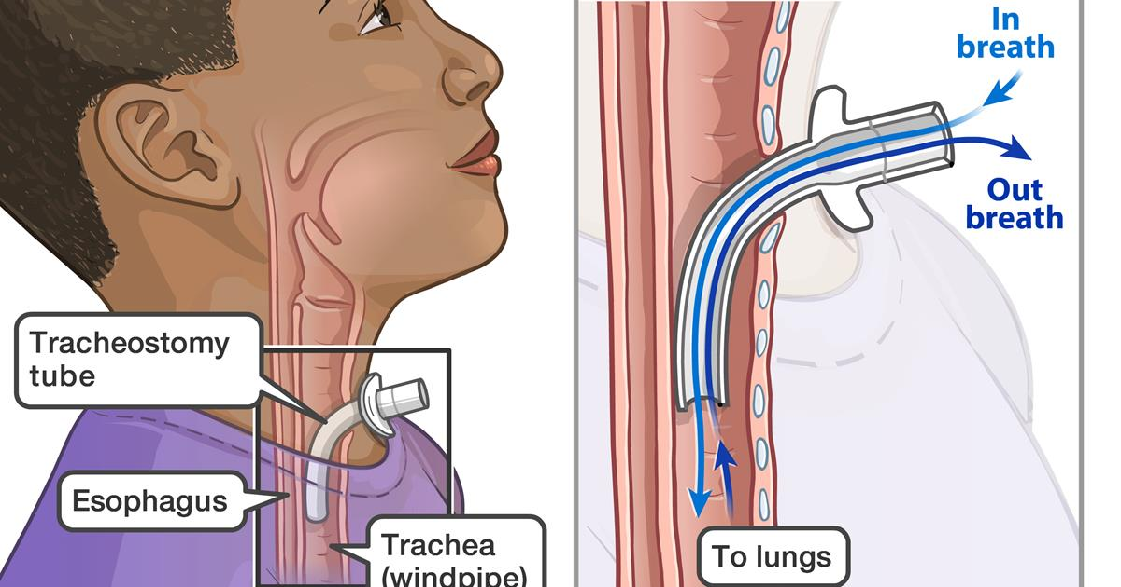
To be discharged from the hospital on a ventilator the patients need a tracheostomy
A surgical hole in the neck that allows them to be hooked up to a ventilator

Slide 7
Bronchopulmonary Dysplasia
Approximately 2-4% of infants with BPD require a tracheostomy
up to 12% with severe or grade 3 BPD
Benefits to performing a tracheostomy include:
providing a stable airway
weaning sedation requirements
improving ventilator synchrony
improving growth
promoting age-appropriate interactions
improving participation in developmental care
tracheostomy performed within 4 months of age is associated with improved outcomes

Slide 8
Bronchopulmonary Dysplasia
Risks associated with a tracheostomy
Increased risk of death (vs no tracheostomy)
Accidental decannulation – can lead to death
Cannula obstruction – can lead to death
Increased rates of infection (skin, trachea and lungs)
Tracheal stenosis

Slide 9
The Problem
Who really needs a tracheostomy?
What is the ideal time frame to refer a patient for tracheostomy?

Slide 10
Our goal
To develop statistical models using clinical data at 36 and 44 weeks post-menstrual age (PMA) to predict eventual need for tracheostomy or death prior to discharge

Slide 11
The Data Set
Multicenter, retrospective case-control study across 9 centers of the BPD Collaborative
The data set includes infants born at ≤32 weeks PMA
Birth and demographic data
Respiratory support at 36 weeks and 44 weeks PMA
Outcomes at discharge

Slide 12
Variables of Clinical Interest
Birth Variables
Weight (was the baby small for gestational age?)
gestational age
prenatal steroids
maternal race
gender
chorioamnionitis

Slide 13
Variables of Clinical Interest
Variables at 36 and 44 weeks CGA
Weight
Tracheostomy?
Respiratory support variable
Level of support (nothing, FiO₂, non-invasive support, invasive support)
PEEP
Fraction of inspired O₂ (FiO₂)
Peak inspiratory pressure
Pulmonary Hypertension (associated with worse outcomes)

Slide 14
Outcome of Interest
Tracheostomy at discharge?
Death before discharge?

Slide 15
Questions
Robin_mckinney@brown.edu

